Slide 1
Automatic attendance system using Face recognition
Vikrant Singh Jamwal
Roll number: 03116401517
B. tech IT 8th Semester
Mentor:
Professor Navin Rajpal

Slide 2
Problem Statement
Attendance marking in a classroom during a lecture is not only a difficult job but also time consuming.
Due to high number of students present during the lecture there will always be a probability of proxy or missed attendance.
Marking the attendance with conventional methods has been a challenge for teachers.
The need of saving time and creating an automatic techniques of marking attendance is very important for the future of efficient work.

Slide 3
Basic Idea behind the Project
Video capture:
The video of the class can be captured from the platform where the meeting is occurring. This video is then moved to the detection folder inside the software.

Slide 4
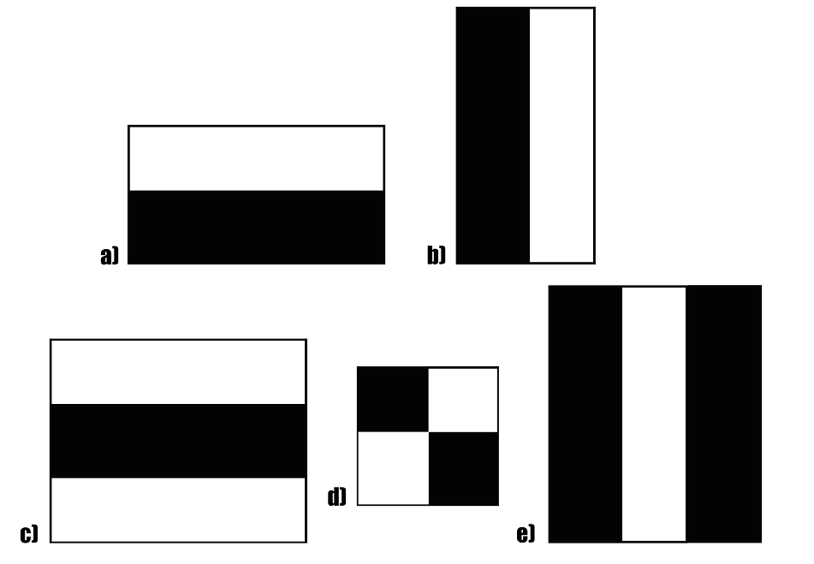
Basic Idea behind the Project
Face Detection:
First the face is detected using Haar-Cascade and OpenCV by detecting the smile, eyes and nose.
Haar Cascade is used to detect a face by adding the white parts of the rectangle with the black parts.

Slide 5
Basic Idea behind the Project
Face recognition:
After detection the face is then compared to the images present in the database.
Multiple frames of the captured videos are used to compare with the images of the students in the database.
LBPH algorithm is used to compare two histograms and gives the closest result.

Slide 6
Basic Idea behind the Project
Data updating:
After recognition of the face, the excel file is accessed using libraries like pandas and csv.
The face IDs that were recognised are recorded and marked present in the csv file and then converted back to the excel file.
There are multiple ways of updating the excel file, one of them is by using openpyxl library to create a work station for excel updating.

Slide 7
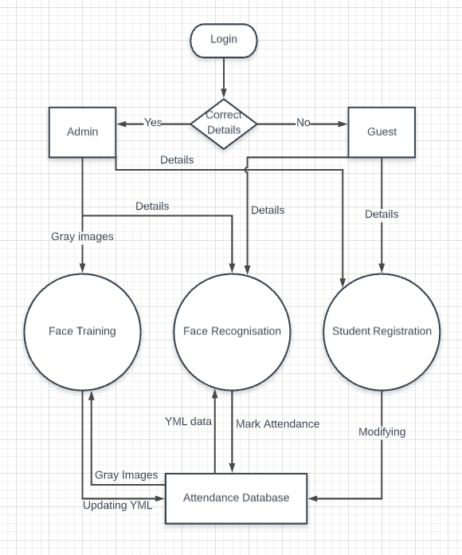
Flow Chart

Slide 8
Project UI and Working
The Project is divided into 6 major parts:
Login
Register
Train
Recognise
Updating the Excel
Viewing the Excel

Slide 9
Login

Slide 10
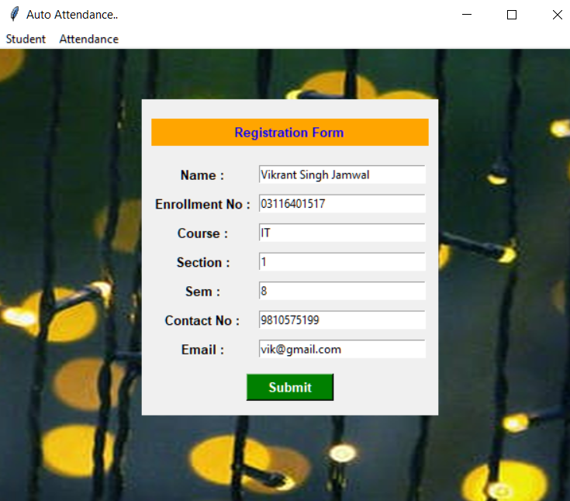
Register

Slide 11
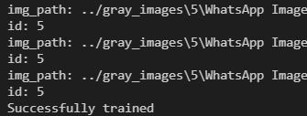
Train
Train program is used to create a YML document which saves the threshold of the 8 neighbouring pixels in the image.
IDs are created and linked to the face detected using haar-cascade and are saved in the YML document.

Slide 12
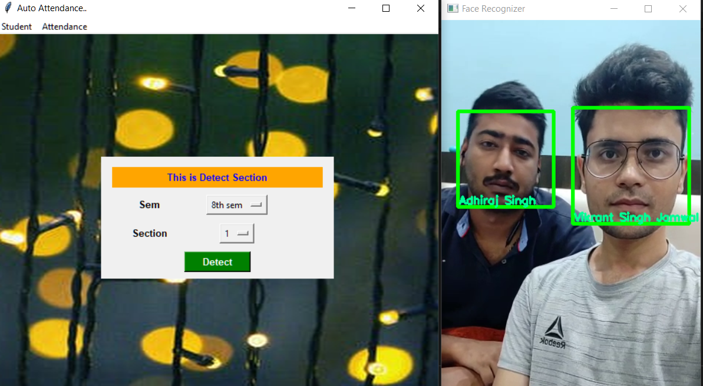
Recognise
Detect opens up the given video and starts recognizing the faces seen in the video.
As a face is recognised in 20 frames and has a confidence<80, then it is saved in an array which later is updated as attendance in the database.

Slide 13
Updating Excel file
After recognising the students, the excel file is updated. The heading attribute is the present Date and the default value under it is A(Absent).
As the excel file is updated the P(Present) is written in front of the names of the students recognised in the given video.
Holidays are imported from the python packages to find out that any holiday lies on the present date or not.

Slide 14
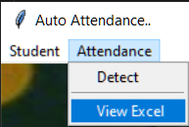
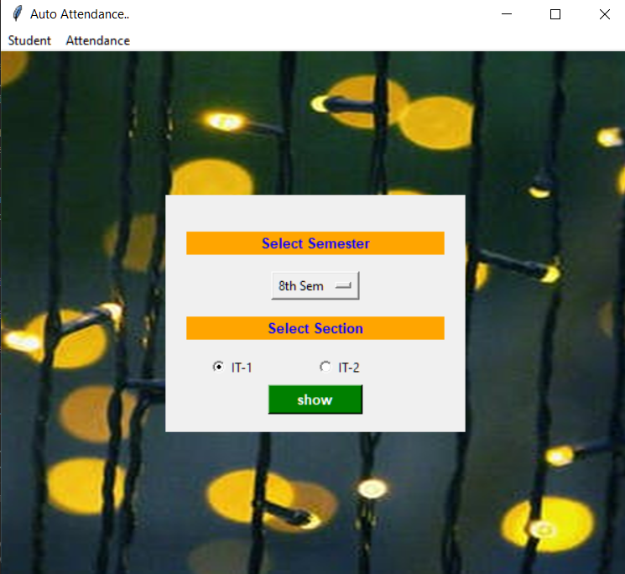
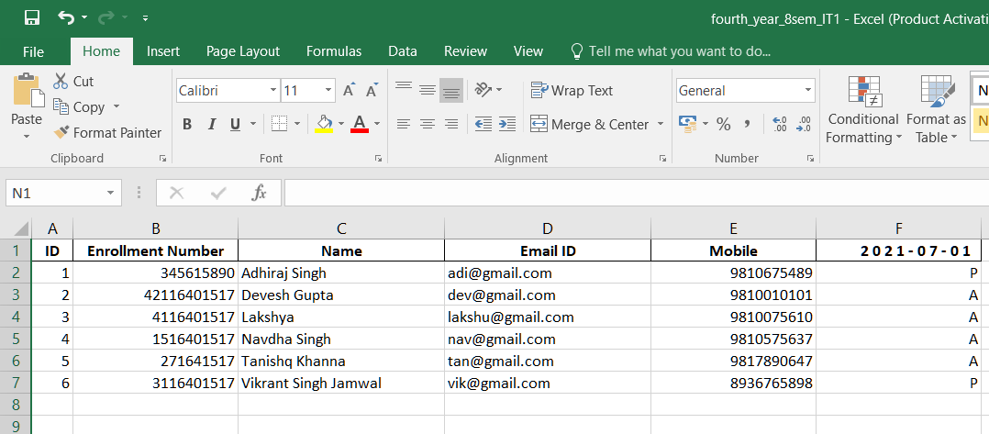
Viewing The Excel

Slide 15
THANK YOU

